Slide 1
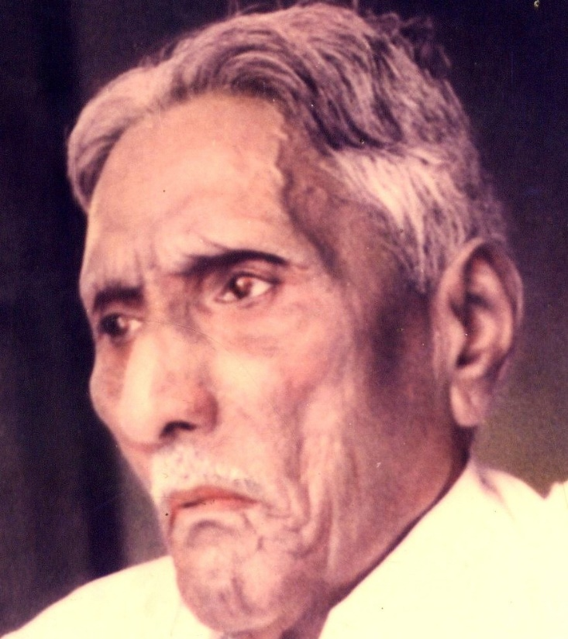

The Bible Mission The Revelation of God to St. M. Devadas The Bible Mission’s Annual Conference

Slide 2
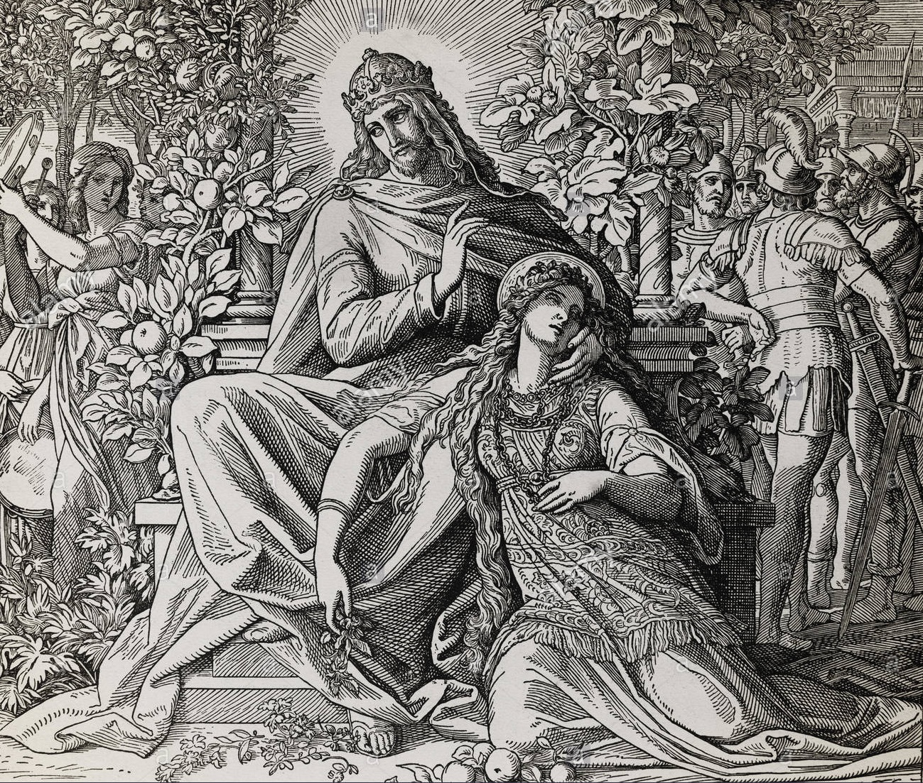
Persecution : The Perfection of Bride The Persecuted Bride in the song of Solomon

Slide 3
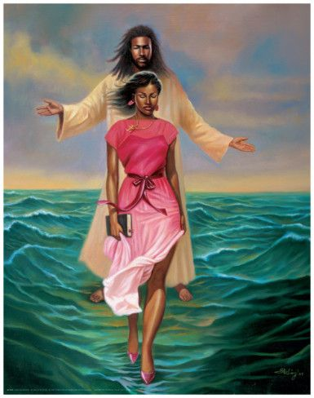
1.Complexion, Confrontation (1:5)
2.Rejection, Repatriation (1:6)
3.Veil and travail (1:7)

Slide 4
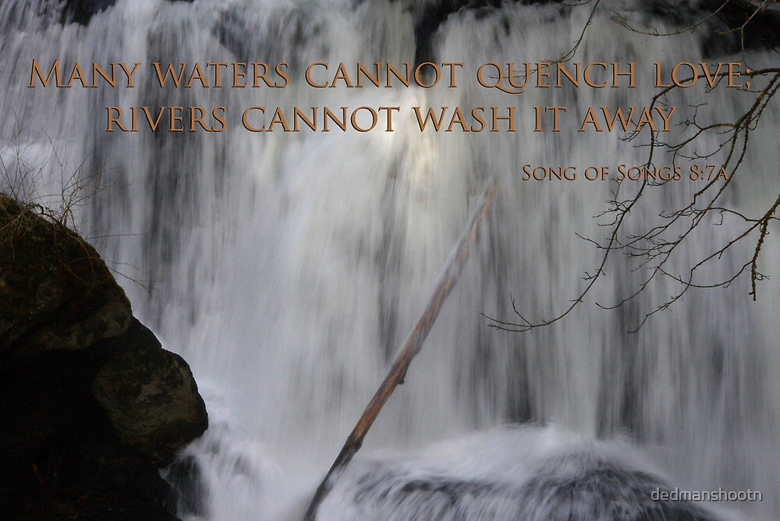
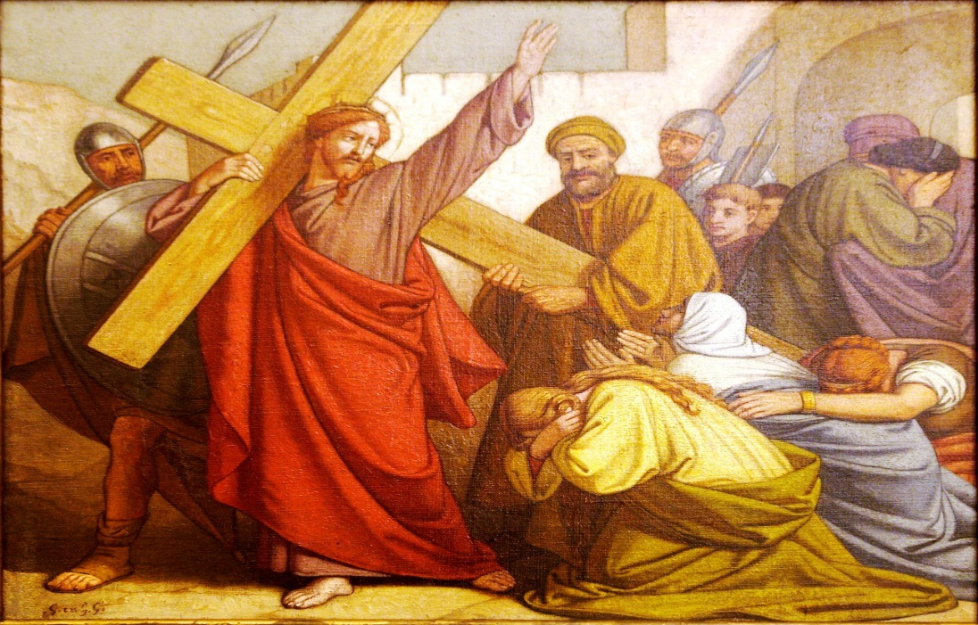
4.Scorn and Scoff (8:7) (8:1) ;
5.Disturbance caused by the daughters of Jerusalem (2:7)
6.The wall of obstruction (2:9)

Slide 5
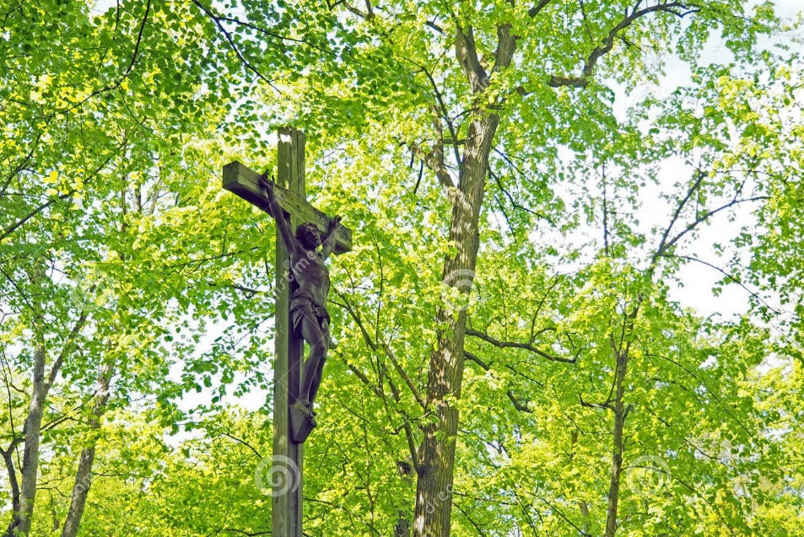
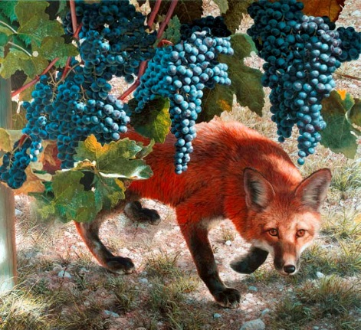
7.The season of stagnation (2:11)
8.The roots of destruction (Foxes and small foxes) (2:15)
9.The slumbers of night (3:1) (5:2);

Slide 6
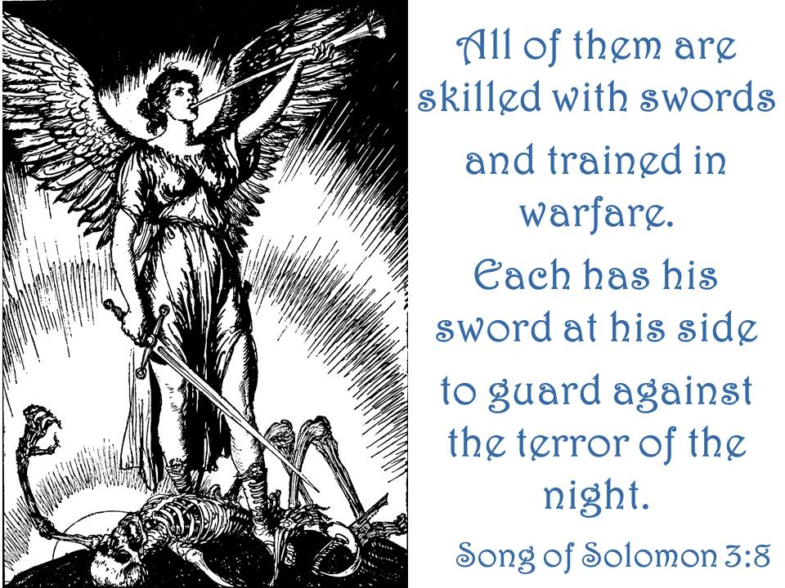
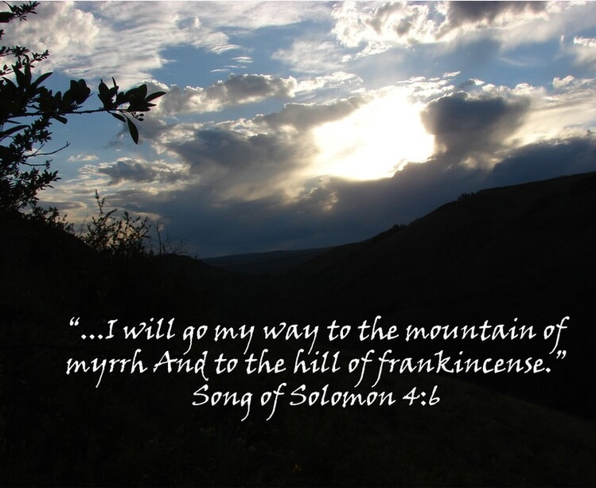
10.The scares of night (3:8)
11.The shadows of night (2:17) (4:6);
12.The season of irritation (4:6)

Slide 7
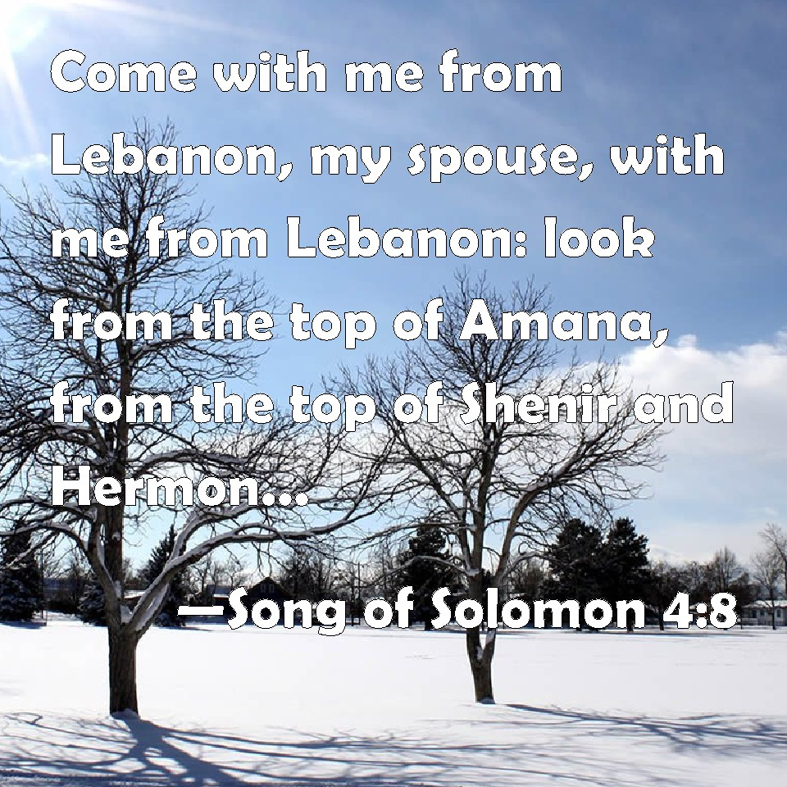
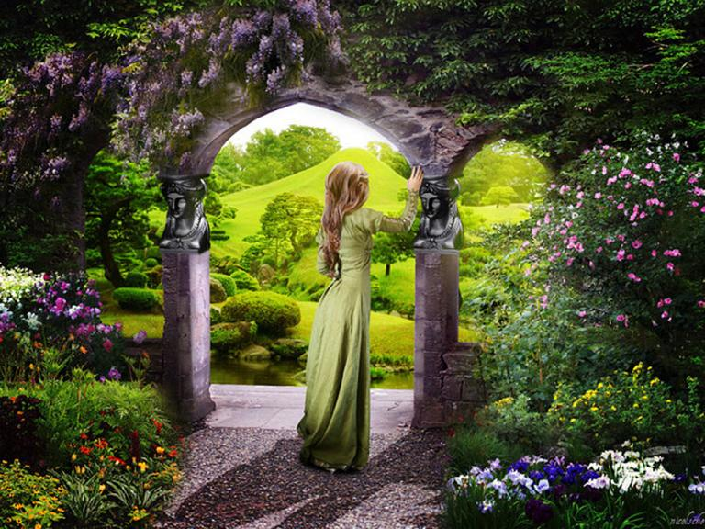
13.The season of hesitation (5:3)
14.The lofty mountains of Leopards and Lions dens (4:8)
15.The state of being sealed, enclosed and shut up (4:12)

Slide 8
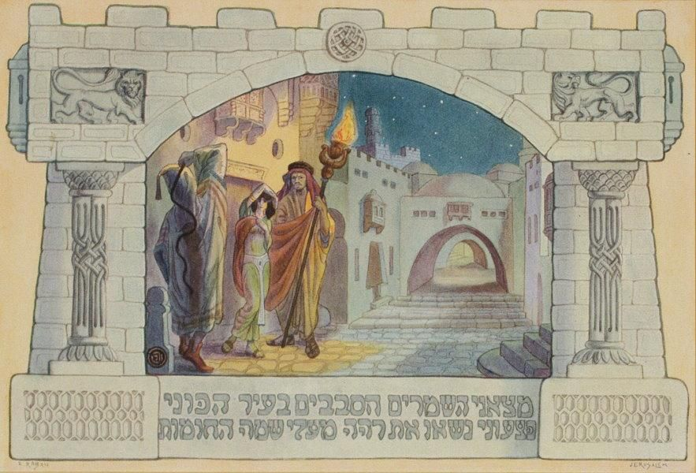
16.The state of being fainted (5:6) (2:5)
17.The hurting watchmen (5:7,8)
18.The stealing Keepers (5:7) ;

Slide 9
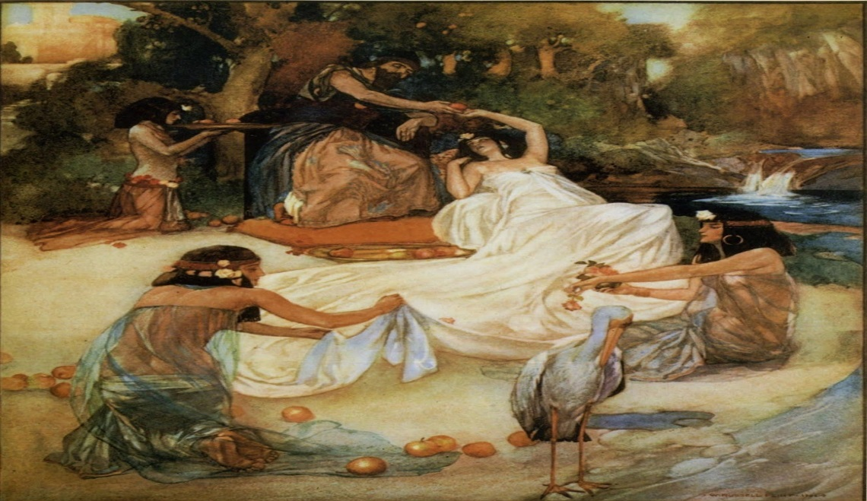
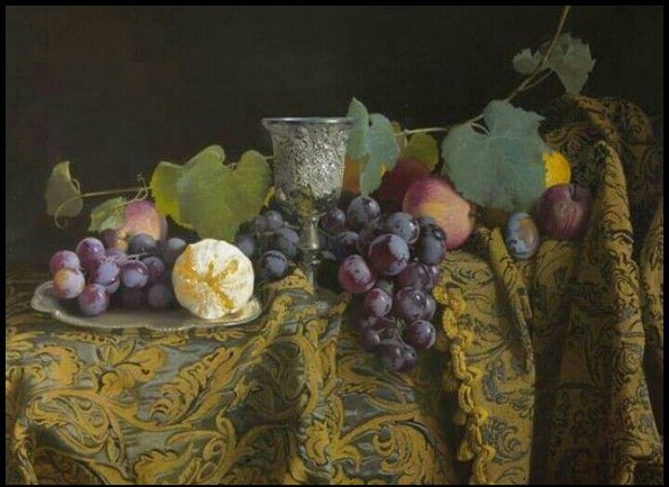
19.The season of birth pangs (8:5)
20.The deep waters (8:7)
21.The unripen fruits (7:13)

Slide 10
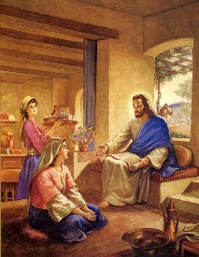
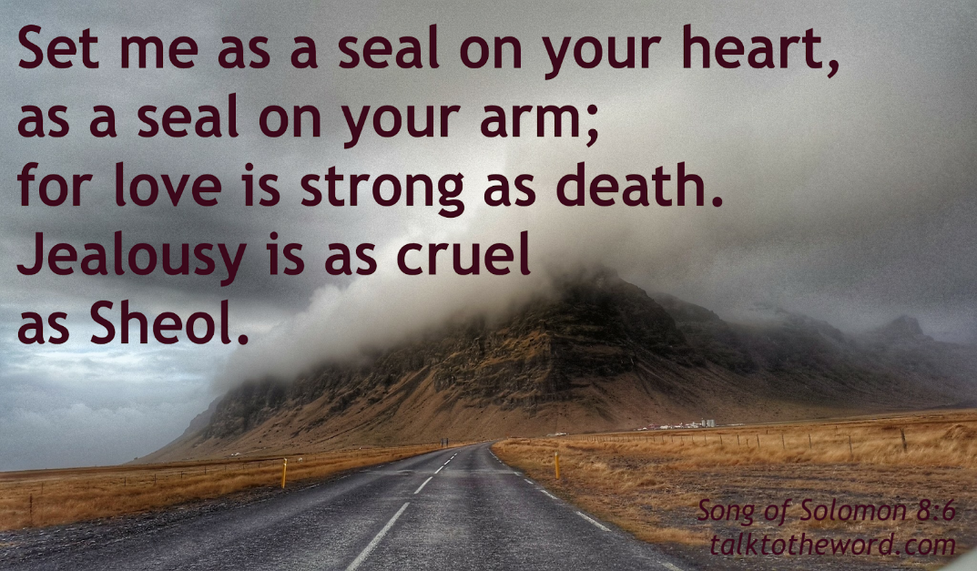
22.The immatured sister (8:8)
23.The raging flames (8:6)

Slide 11
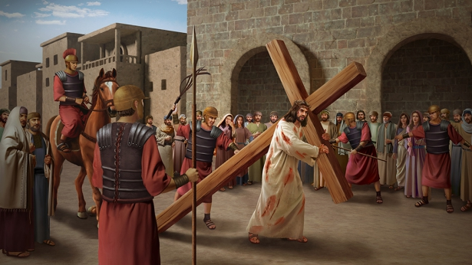
Persecution is of two types:
2. Persecution : Perfection of the Bride
a) External Persecution
b) Internal affliction

Slide 12
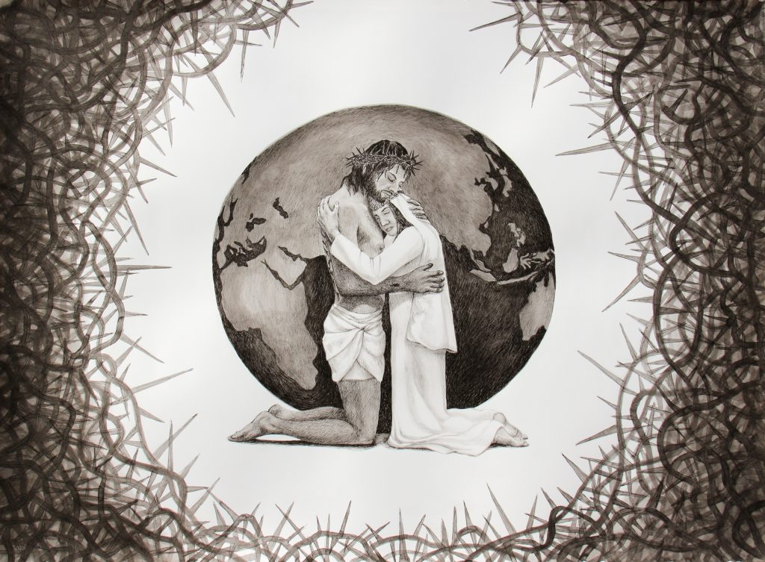
In the song of solomon, we are referring to internal affliction or suffering of the bride.

Slide 13
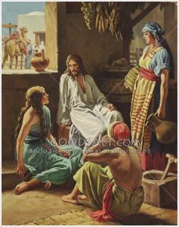
“Like a lily among thorns is my love among the maidens” song of solomon(2:2)

Slide 14
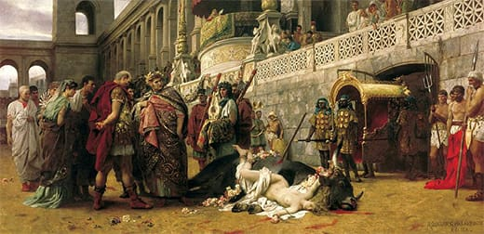
The Spirit of Righteous Intolerance:
Get rid of all bitterness and anger.

Slide 15
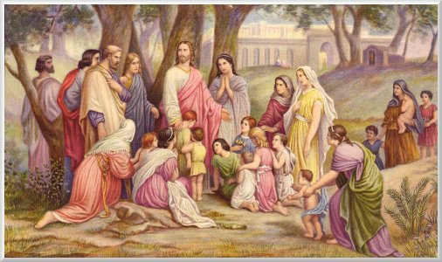
The Spirit of indignation and looking down:
Don’t let the sun go down on your anger

Slide 16
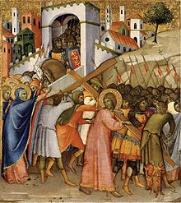
For Christ’s sake, delight in weakness, in insults, in hardships, in persecutions.

Slide 17
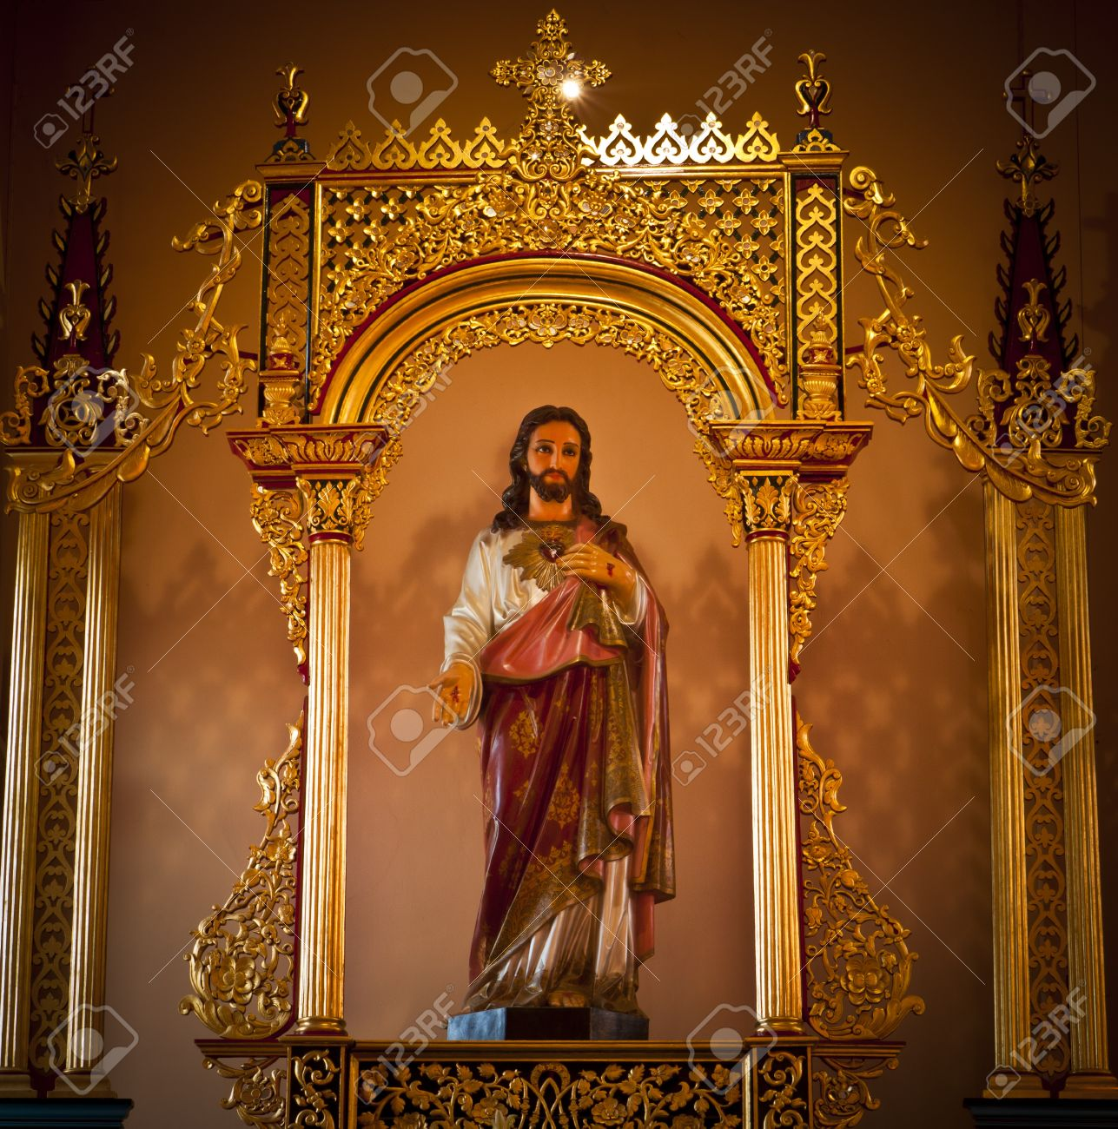
The Church which loves the world is with worldly pride and pomp.

Slide 18
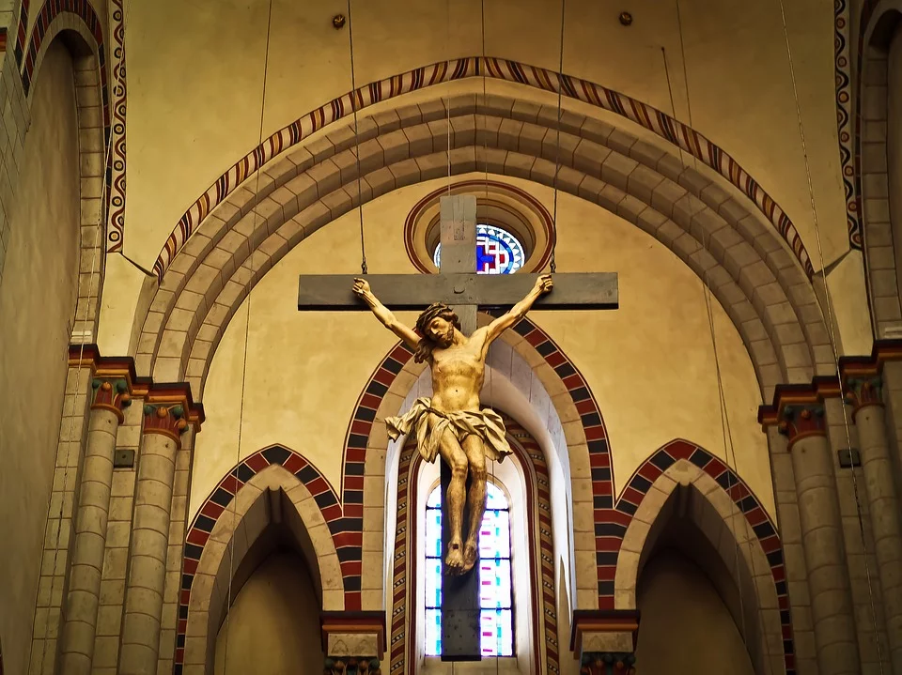
The church which is far from the world is being looked down by worldly churches and persecuted by the world.

Slide 19
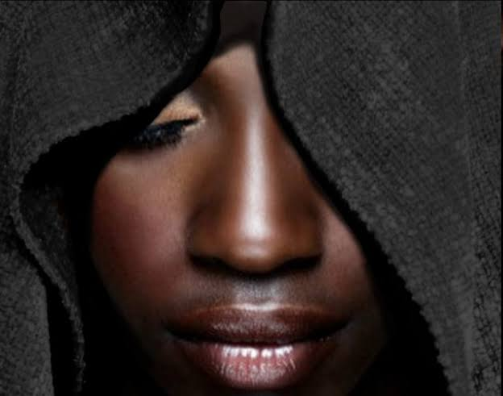
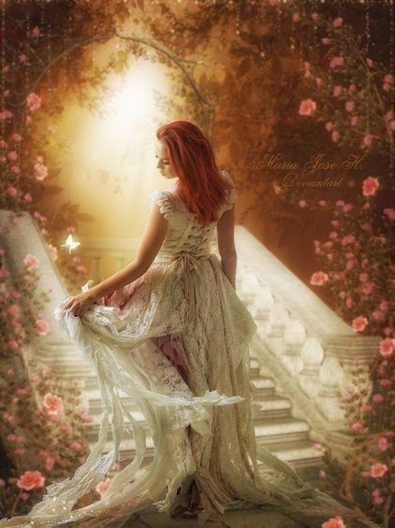
3.Persecution resulting in the perfection of the Bride in Song of Solomon
Persecution | Perfection
Dark Complexion | More Beautiful
Being Looked upon | Fairest among women
Tanned by the Sun | Fair as the Moon, Bright as the Sun

Slide 20
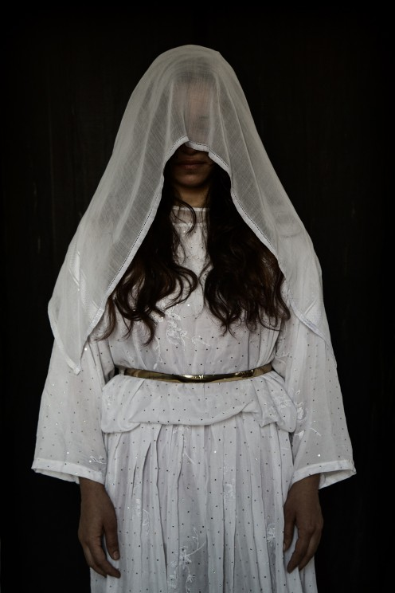
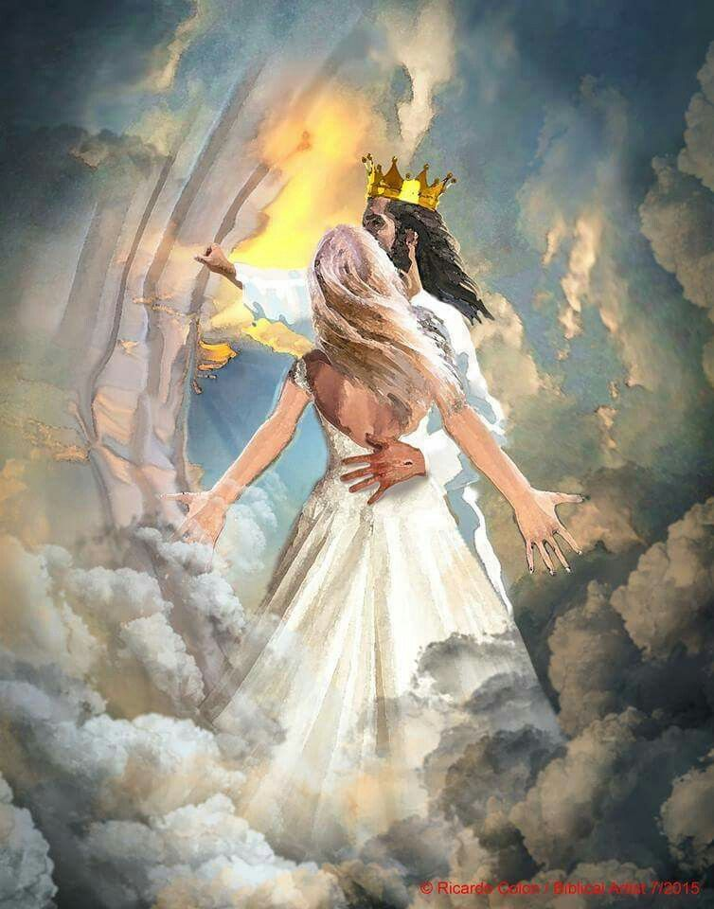
Persecution | Perfection
Anger of Brothers | Praised by the Queens
Keeper of vineyards | An Army with banners
Being veiled and made to wait | Being crowned like Mount Carmel
Being stirred up | Being carried in Solomon’s couch

Slide 21
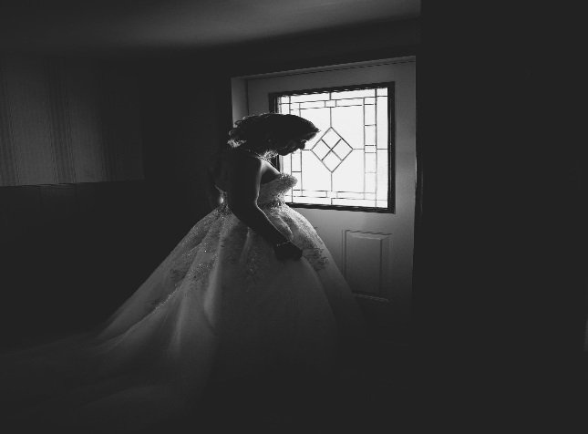
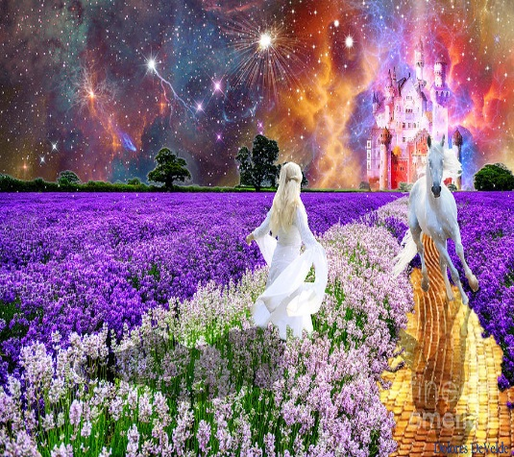
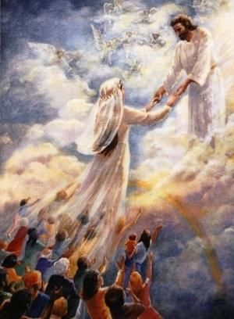
Persecution | Perfection
Winter stagnation | The singing of spring(season)
Foxes and little foxes that ruin vineyards | Pleasant fruits of all manner – New and Old
The slackness of night | Holding the Groom tight without letting him go again
The silent keepers (Un assisting) | Un Quenchable quest to find the Groom

Slide 22
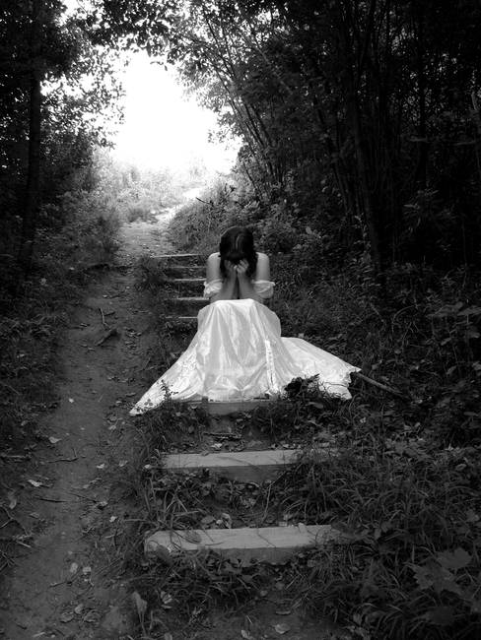
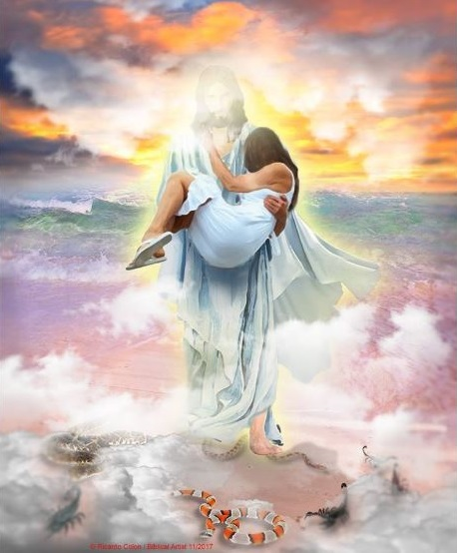
Persecution | Perfection
The scares of night | Being carried in the Couch
The Mountains of Leopards and the dens of Lions | Made as the chariots of Amminadab
Self – Debilities (Fraility 5 ,6) | Sustainable faith (Unconquerable) (6:3)

Slide 23

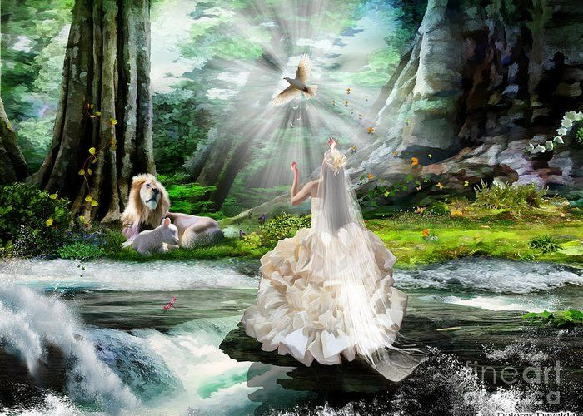
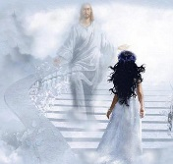
Persecution | Perfection
Blows and wounds | Fair and Pleasant with all the delights.
Being despised (8:1) | 17.Unique state; The only one ; The dearest one (6:9)
Birth pangs (8:5) | To become multitudes (A Holy Nation and Royal Priesthood)

Slide 24
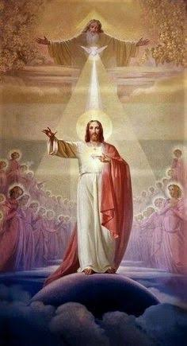
May the Holy Spirit Father Bless and Establish all of us to be His Bride.
AMEN

